Slide 1







Playing with Tiny bit
Playing black paino
Yahboom

Slide 2









Contents
Preparation
Learning goal
Search for blocks
Combine blocks
Experimental phenomena
Yahboom

Slide 3

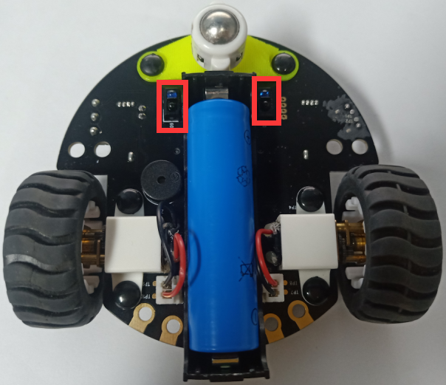
Preparation
The position of the tracking sensor module in the robot
In the picture shown below, the tracking module with red wire frame.
Yahboom

Slide 4
Preparation
Learn about the principle of tracking module
The basic principle of the tracking sensor is to use the reflective nature of the object.
Our experiment is to tracking the black line. When the infrared light is emitted to the black line, it will be absorbed by the black line. When the infrared light is emitted to the other color line, it will reflected to the infrared receiver tube.
Yahboom

Slide 5
Preparation
Programming method:
Mode 1 online programming: First, we need to connect the micro:bit to the computer by USB cable. The computer will pop up a USB flash drive and click on the URL in the USB flash drive: http://microbit.org/ to enter the programming interface. Add the Yahboom package: https://github.com/YahboomTechnology/Tiny-bitLib to program.
Mode 2 offline programming: We need to open the offline programming software. After the installation is complete, enter the programming interface, click【New Project】, add Yahboom package: https://github.com/YahboomTechnology/Tiny-bitLib, you can program.
Yahboom

Slide 6
Learning goal
1.Learn how to use line sensor graphically program building blocks and control motor graphically program building blocks
2.The function is realized by programming: while the Tiny-bit is moving forward on the white bottom surface, the line sensor detects black, it lights up red and the buzzer plays different tones.
Yahboom

Slide 7

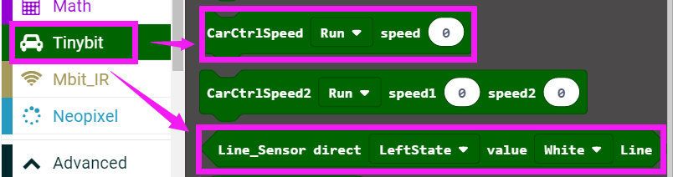
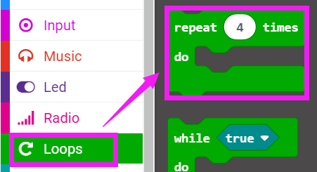
Search for block
The following is the location of the building blocks required for this programming.
Yahboom

Slide 8
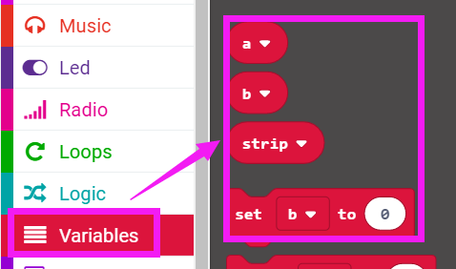
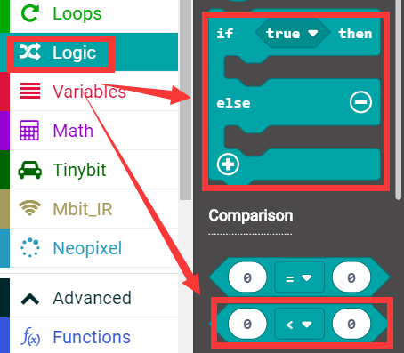
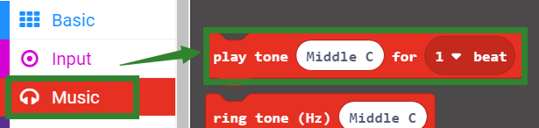
Search for block
Yahboom

Slide 9
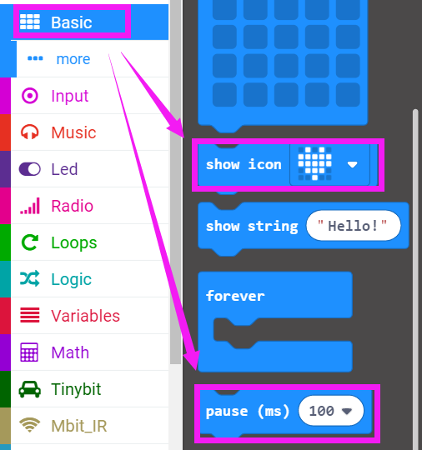
Search for block
Yahboom

Slide 10
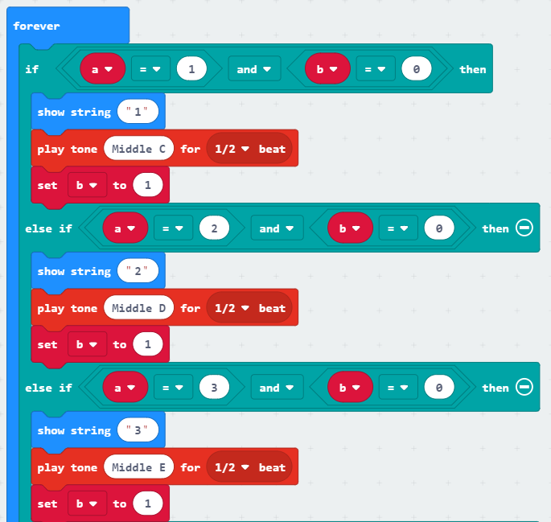
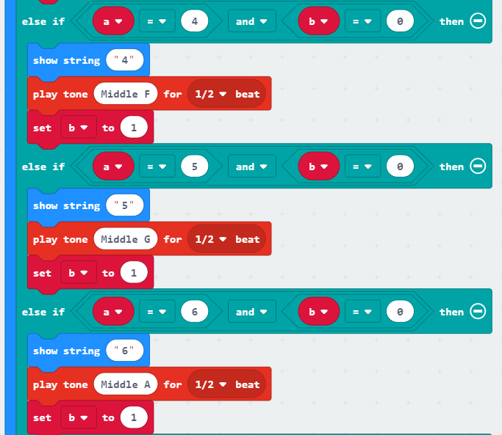
Combine block
The summary program is shown below:
Yahboom

Slide 11
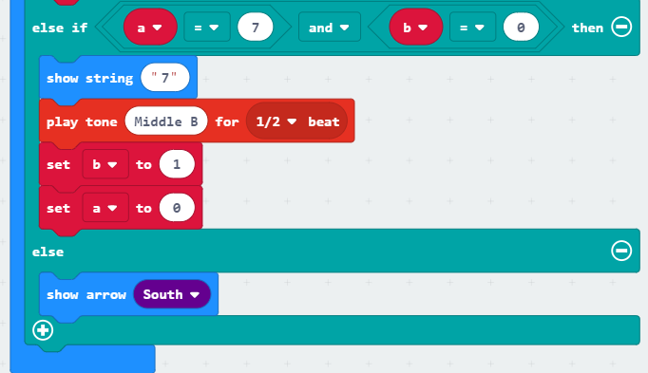
Combine block
Yahboom

Slide 12
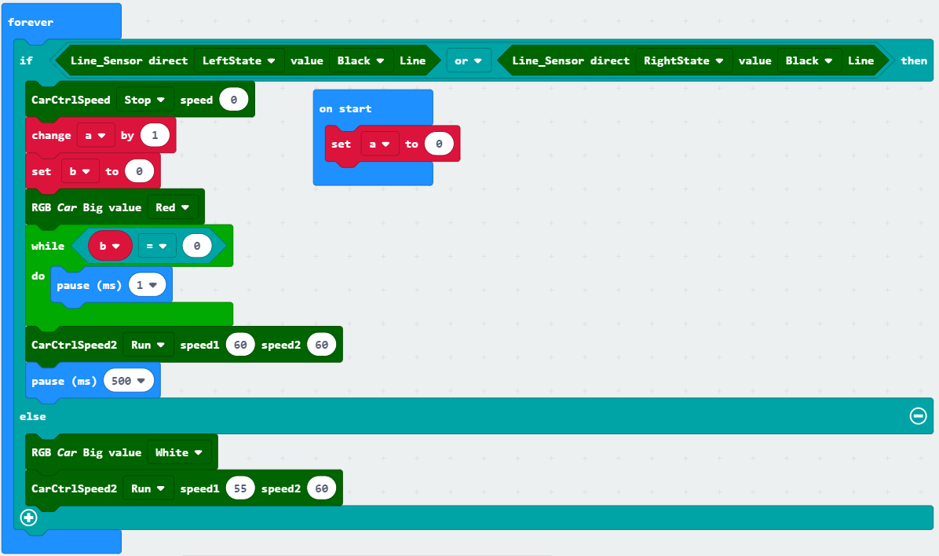
Combine block
Yahboom

Slide 13
Experimental phenomena
After the program is downloaded, we put the Tiny-bit on the field with 7 black squares on the white background, open the power or the robot car, Tiny-bit will advance, the micro:bit dot matrix will display a forward arrow. And the RGB searching light is white.
When the line sensor detects black, the RGB searching light will become red, the buzzer paly different tones, and the micro:bit dot matrix displays numbers.
When the black square is detected for the first time, the micro:bit dot matrix will display "1", the buzzer will play“do”
When the black square is detected for the second time, the micro:bit dot matrix will display "2", the buzzer will play “re”
When the black square is detected for the third time, the micro:bit dot matrix will display "3", the buzzer will play “mi”
.....
When the black square is detected for the seventh time, the micro:bit dot matrix will display "7", the buzzer will play “si”
When the black square is detected for the eighth time, the micro:bit dot matrix will display "1", the buzzer will play“do”
.......
Tip: Not necessarily black squares, you can use black pens to draw black blocks of various shapes.
Yahboom

Slide 14
Inspire Creativity Embrace Innovation
Thank you!!!

